Slide 1
[MDU21AJ003]-[E-Learning Management]
POD Member Name -
Avani Maheshwari (924089)
Kanishka Mahure (924101)
Shubhankar Paul (924322)
Sandhya Choudhari (924386)
Aniket LNU (924168)
Manish Dewangan (924141)
Date of Design - 29-06-2021

Slide 2
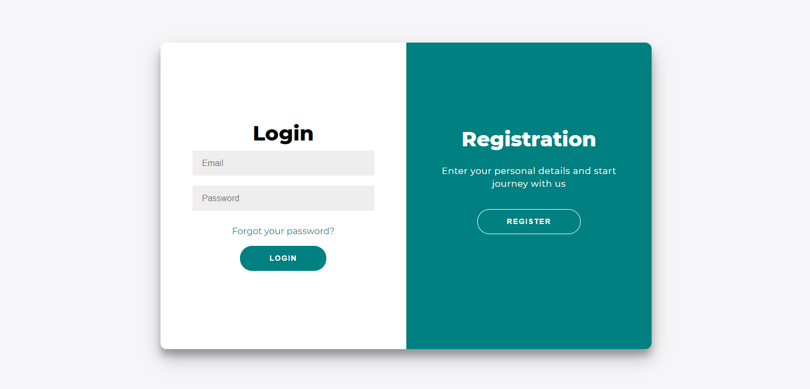
User Login Page -

Slide 3
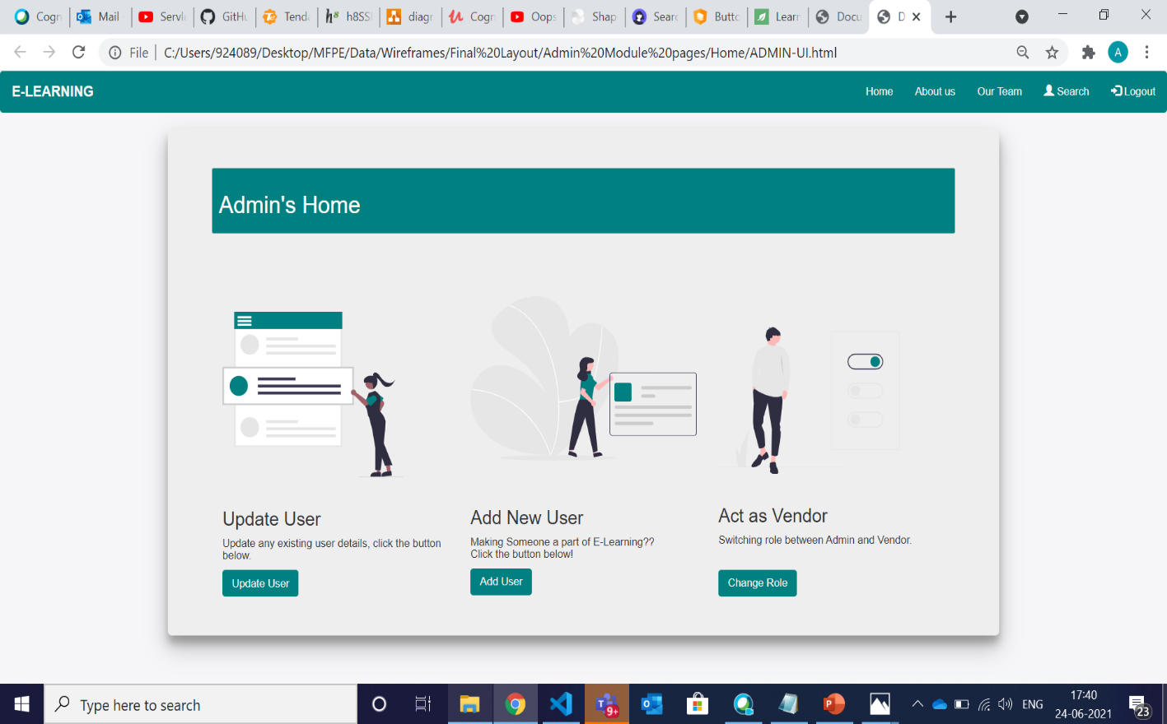
Admin’s Home Page -
© 2020 Cognizant

Slide 4
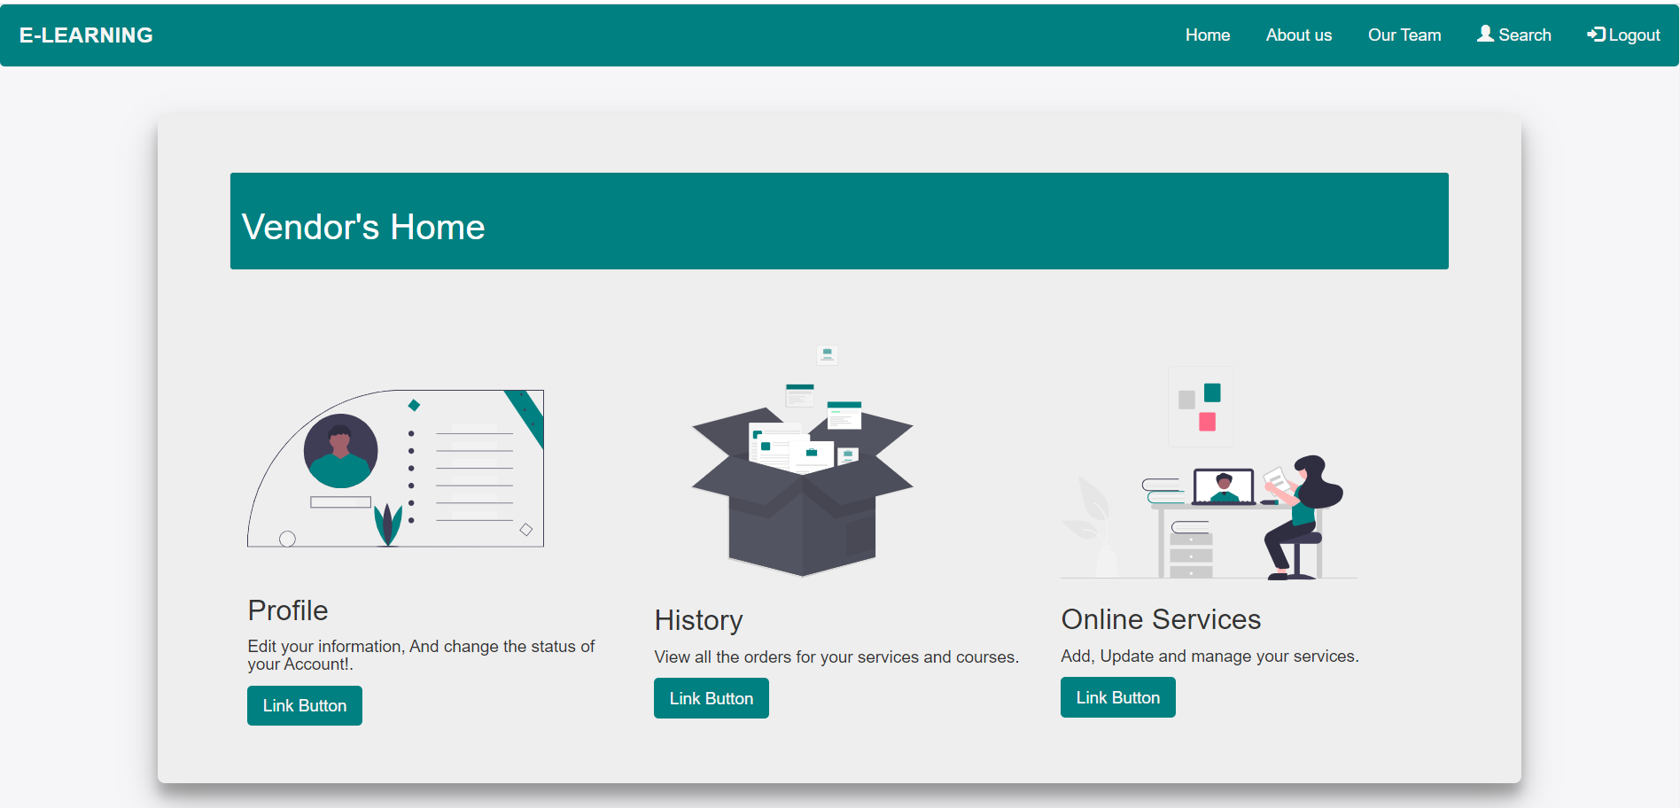
Vendor’s Home Page -

Slide 5
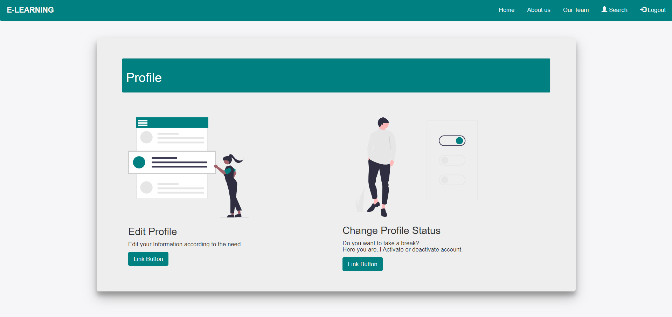
Vendor’s Profile Page -
© 2020 Cognizant

Slide 6
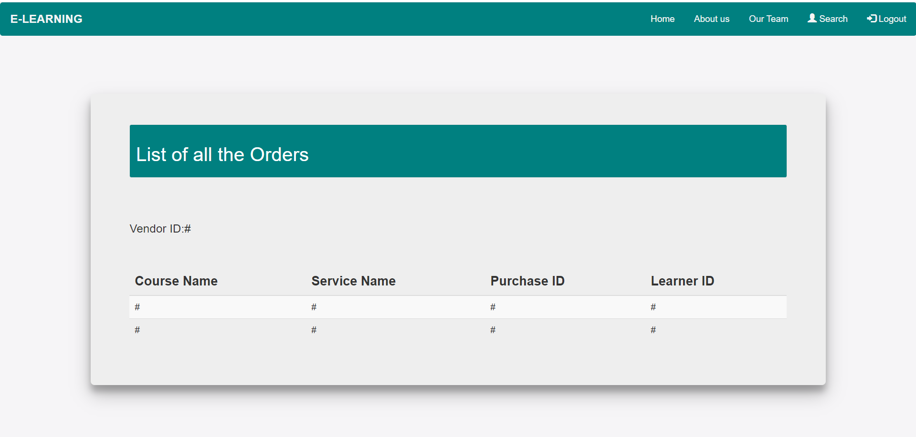
Vendor’s Selling History Page -
© 2020 Cognizant

Slide 7
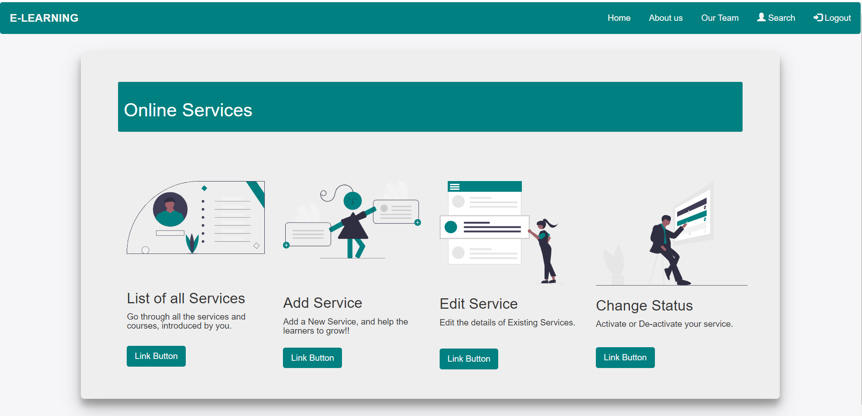
Vendor’s Online Services Page -
© 2020 Cognizant

Slide 8
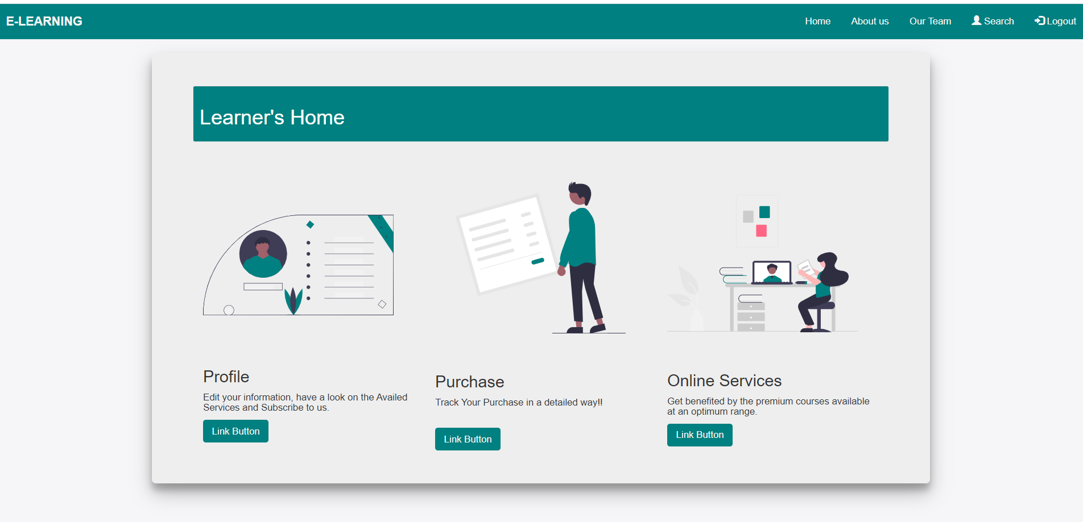
Learner’s Home Page -
© 2020 Cognizant

Slide 9
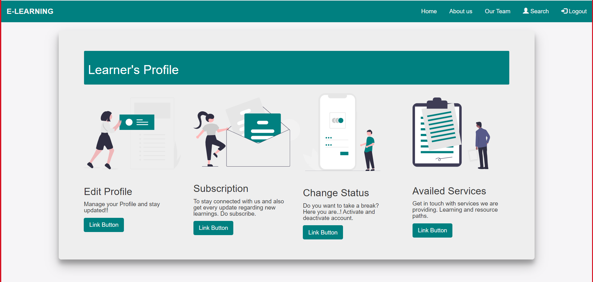
Learner’s Profile Page -
© 2020 Cognizant

Slide 10
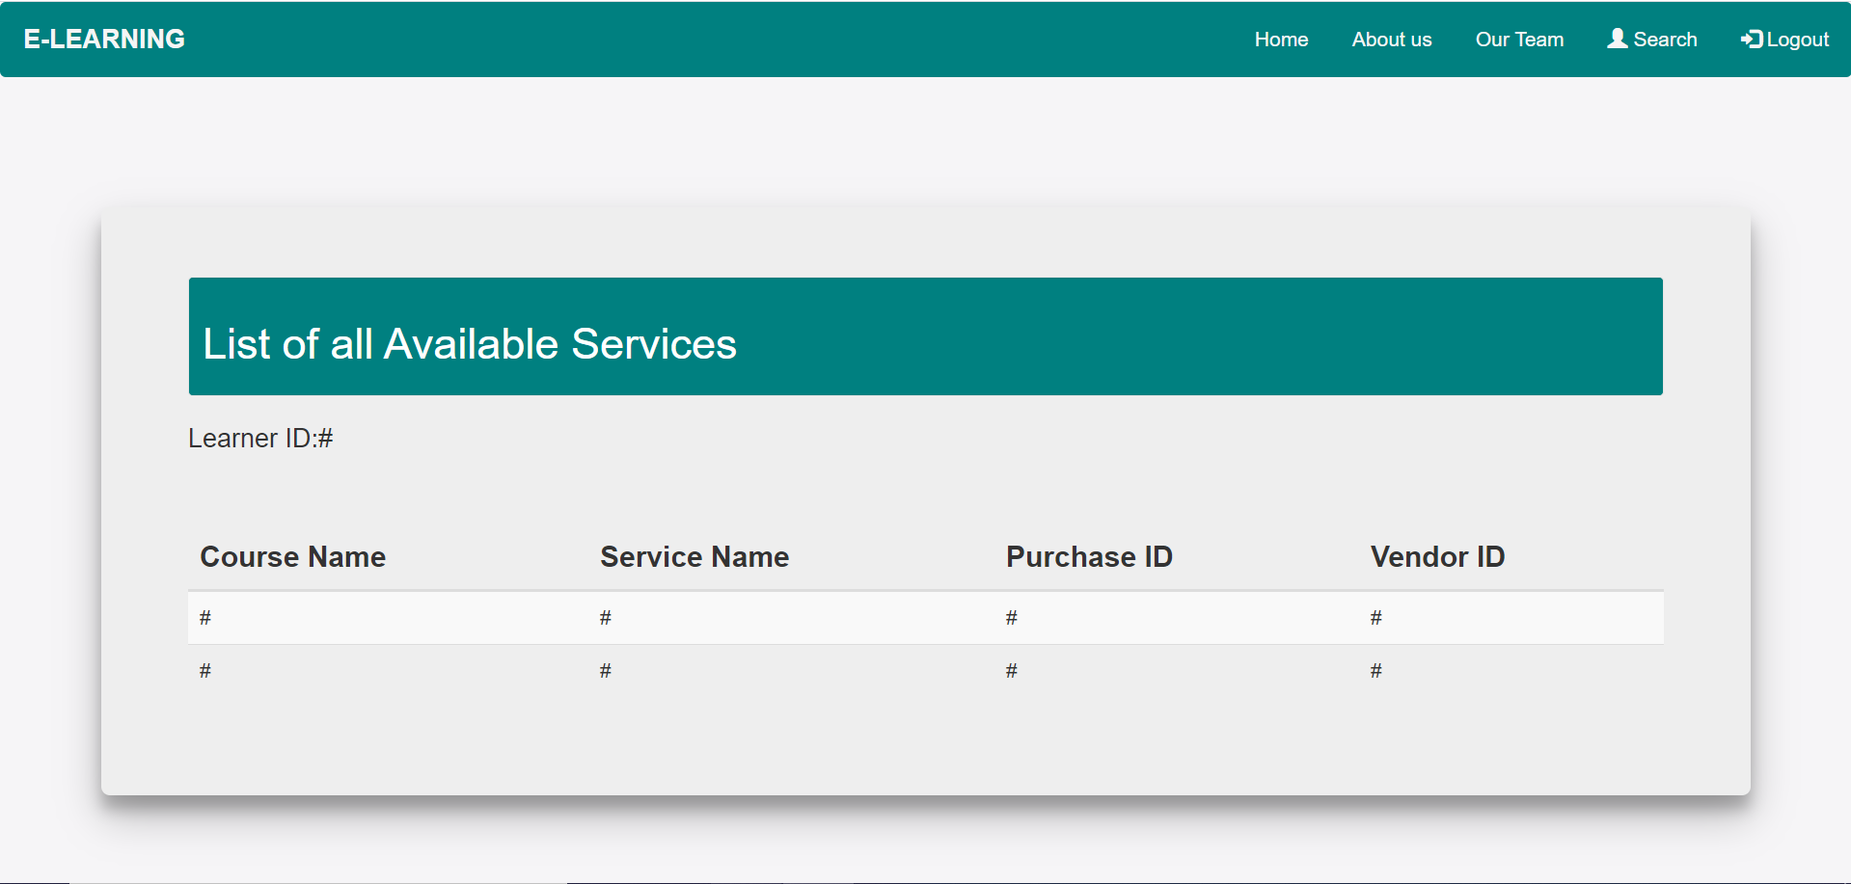
Learner’s Purchase History Page -
© 2020 Cognizant

Slide 11
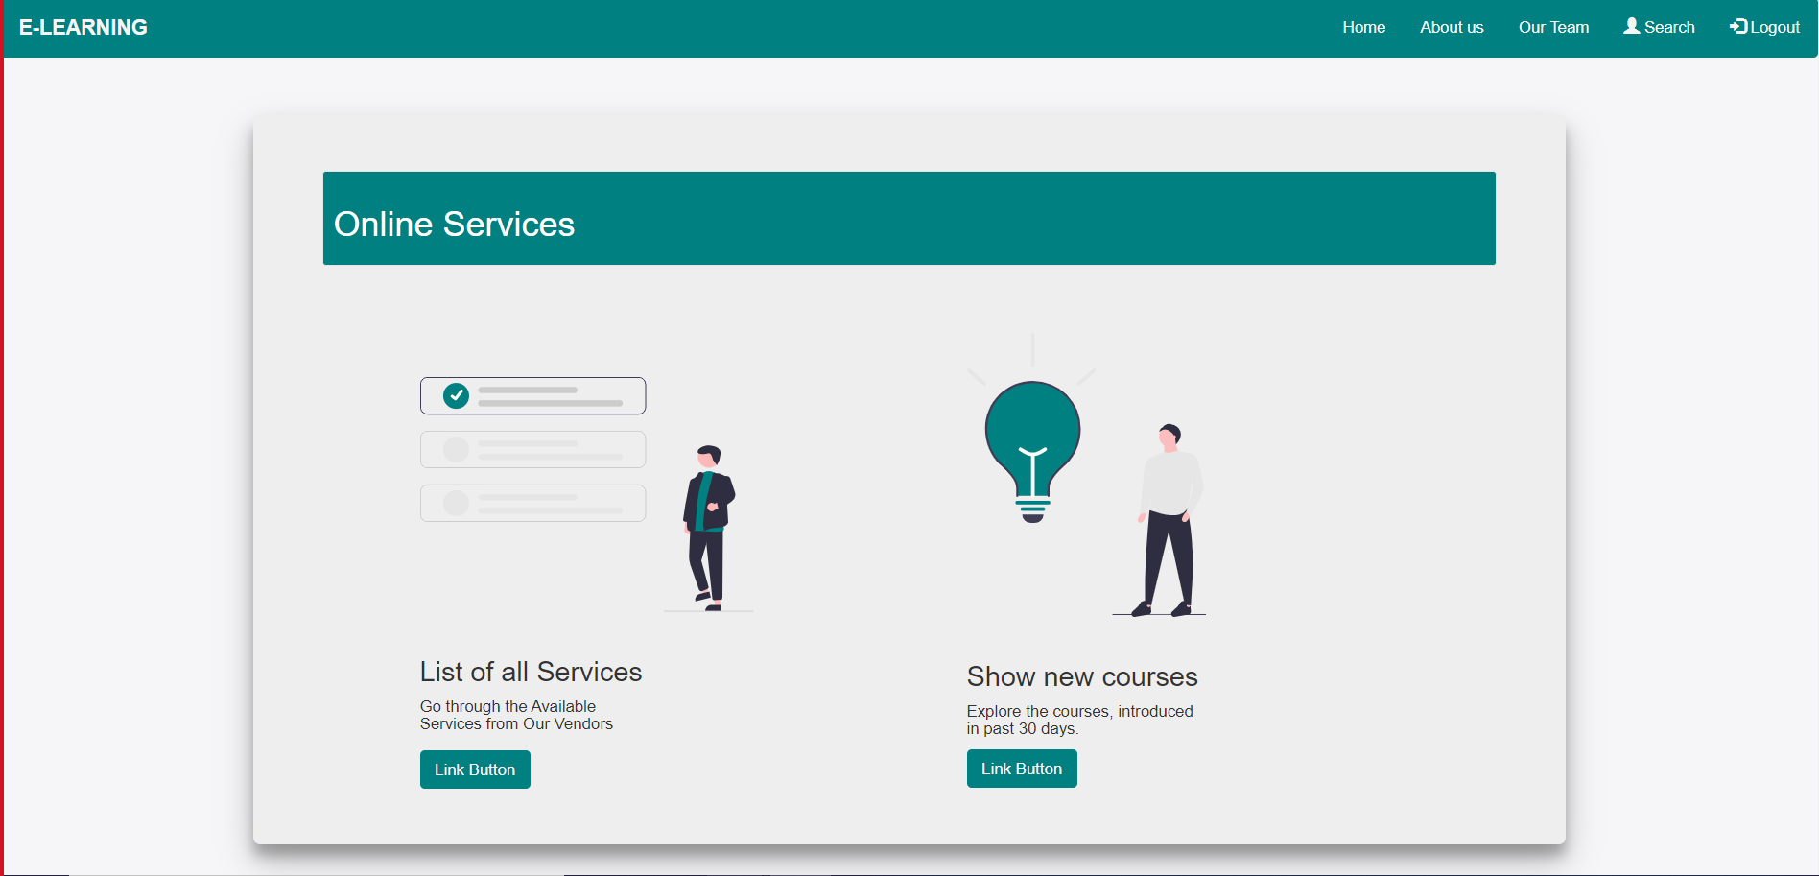
Learner’s online Services Page -
© 2020 Cognizant

Slide 12
Thank You!
POD Member Name -
Avani Maheshwari (924089)
Kanishka Mahure (924101)
Shubhankar Paul (924322)
Sandhya Choudhari (924386)
Aniket LNU (924168)
Manish Dewangan (924141)
© 2020 Cognizant

